Slide 1

EMBEDDED SYSTEMS CAPSTONE PROJECT
Embedded System Health Monitoring System
Real-time diagnostic telemetry, multi-channel parameter acquisition, and automated fault threshold processing.
AENEXZ Platform Hardware In The Loop
AUTHOR & LEAD
DISCIPLINE
CORE STACK
Dharun Raj
Electronics & Communication
STM32 • Wokwi • I2C • UART

Slide 2
CONTEXT & BASELINE
System Overview & Specifications
Project Metadata
Core Engineering Focus
Lead Developer: Dharun Raj
Continuous Telemetry: Sub-cycle hardware metric capture
Domain: Embedded Systems Engineering
True RMS Processing: Root-mean-square calculation engines
Processor Target: STM32 Arm Cortex Architecture
Health Aggregation: Stress index and accumulated power draw
Simulation Engine: Wokwi Virtual Prototyping
Dual Telemetry: Local alphanumeric display and PC serial pipeline

Slide 3
FOUNDATION
Health Monitoring Fundamentals
Operational Health
Unified Architecture
Dynamic Sensing
Active sub-system load analysis.
Integrated multi-parameter sensing.
Real-time continuous signal sampling.

Slide 4
SYSTEM RATIONALE
Problem Statement vs Proposed Solution
Existing Challenges
Proposed Embedded Solution
Discrete Hardware: Bulky multi-meter bench setups
STM32 Hub: Single monolithic processing node
Unfiltered Fluctuations: Noisy electrical line readouts
Signal Filtering: Software rolling averages
Blind Spot Drifts: Zero automated cumulative tracking
Real-Time Visuals: LCD & UART health telemetries

Slide 5
CORE GOALS
System Functional Objectives
1
Analog Signal Acquisition
2
True RMS Processing
Periodic dual-channel ADC sampling.
Multi-sample root mean computation.
3
Numerical Calibration
4
Dual Telemetry Output
Scale factors & real power formulation.
I2C 20x4 LCD and 115200 baud UART.

Slide 6
TELEMETRY PERFORMANCE
System Sampling Cadence
1000
Samples Per Second
Continuous ADC conversion pipeline capturing system health variations without loop stalls.

Slide 7
ARCHITECTURE
System Functional Flow & Blocks
SENSOR INPUT BLOCK
Voltage Input (ADC A0)
Current Input (ADC A1)
PROCESSING NODE (STM32 NUCLEO BOARD)
Clock: 64MHz
Analog Acquisition
RMS & Power Calc
Cumulative Energy
Low-Pass Filter
TELEMETRY OUTPUT BLOCK
20x4 I2C LCD Display
UART 115200 Serial Stream

Slide 8
PIPELINE BREAKDOWN
System Architecture Stages
1
2
3
4
5
Input
Acquire
Filter
Calculate
Output
Sensor potential inputs.
Multi-channel ADC reads.
Rolling noise rejection.
RMS power & energy.
LCD and UART transmit.

Slide 9

FORMULATION
RMS & Electrical Processing Equations
Root-Mean-Square Calculation
Instantaneous & Cumulative Load
Instantaneous apparent power consumed per period.
Discrete numerical sampling over window N.

Slide 10

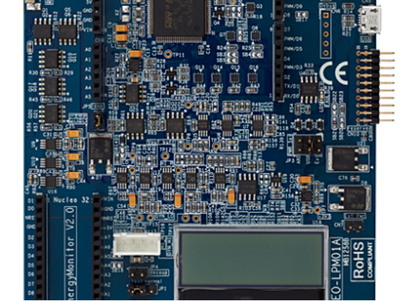
IMPLEMENTATION
Hardware Architecture & Virtualization
STM32 Microcontroller Core
12-bit multi-channel fast analog conversion.
Wokwi Safe Prototyping
Accurate hardware behavior without burn risks.
I2C Communication Bus
Two-wire high speed LCD screen telemetry.

Slide 11
VALUE PROPOSITION
System Strengths & Applications
Sub-Cycle Latency
Cost Efficient
Factory Utility
Sensor Extensible
Real-time health reporting.
Low-cost edge deployment.
Continuous machine diagnostics.
Seamless real-sensor expansion.

Slide 12
HORIZON
Conclusion & Future Enhancements
PHASE 1
PHASE 2
PHASE 3
Physical Transducers
IoT Cloud Uplink
Predictive Health ML
CT current clamps and precision step-down transformers.
MQTT telemetry streaming to cloud anomaly dashboards.
On-device TinyML inferencing for early wear detection.

Slide 13
PROJECT COMPLETION
Thank You
Embedded System Health Monitoring System
Presented by Dharun Raj

Slide 14

Image Sources
https://www.edn.com/wp-content/uploads/news-stm32.png
Source: www.edn.com

